Slide 1
A Tribute to Robert Gates
The University of Toledo Sig Ep President
April 23, 2013

Slide 2
Chi Beta Chi
In the winter of 1928, there was a feeling on the University of Toledo campus that fraternity life was becoming much too social. This feeling was the basis for a new organization on intellectual aspects of college life. This organization, known as Chi Beta Chi, let character, brotherhood, and culture become their watchwords.
In 1929, this new fraternity was registered with the Secretary of State in Columbus, and entered into college life at UT. The first advisor and founder was Dr. Charles J. Bushnell. He organized the first rush in the fall of 1929 at the Collingwood Presbeterian Church. That semester the Chi Beta’s took 11 pledges.
Chi Beta Chi remained an academic fraternity until 1931, when they rented an eight room house and began a full scale social program. In 1933 they continued to expand by taking 27 pledges. In 1938, the fraternity almost died when only seven men returned. These men had an enthusiastic rush program and took 44 new pledges!
In the 1941-42 academic year, Chi Beta Chi member Robert McDermott returned and began work to rebuild Chi Beta Chi. By 1946 there were 10 brothers back and the fraternity began a social program once more. The chapter received a tremendous boost when they bought a house on 335 Winthrop Street for $17,500. Most of the money from this house came from M. Thomas Campbell. Rush began soon after with 26 pledges. The date of the purchase was November 1, 1947

Slide 3
Chi Beta Chi becomes Sigma Phi Epsilon Fraternity September 30, 1950 Over 1500 Ohio Iota Sig Eps today

Slide 4
Robert Gates Signs the Charter

Slide 5
Robert Gates 1950

Slide 6
Robert at the House on Winthrop

Slide 7
335 Winthrop

Slide 8
Bob’s Wedding Reception at the XBX house on Winthrop in August 1950

Slide 9
He married his College Sweetheart, Carol, a Chi Omega from UT

Slide 10
Bob also Serve our Country before joining Chi Beta Chi in 1945

Slide 11
Bob was a Wonderful Father of James, Janet, and Judy

Slide 12
Bob’s Family

Slide 13
Bob Spent his whole Career at Alcoa

Slide 14
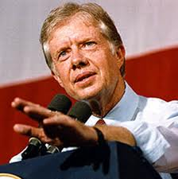
Bob Retired at age 67, and Even worked with President Jimmy Carter

Slide 15
Bob Was an Avid Volunteer
He the Past President of the Pittsburgh Club
President of the Board of Early learning
Member of the Animal Rescue League
Navy League Volunteer
Lifetime Member of the Westminster Presbyterian Church
Even has his Face on a Billboard all over Pittsburgh as an Example on Volunteering !

Slide 16
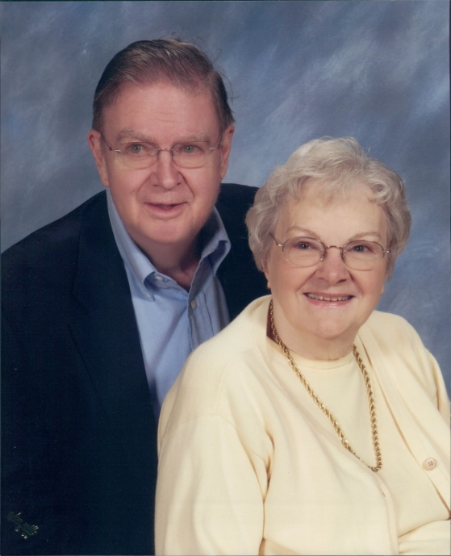
Bob Loved His Hobbys
Gardening
Reading
Woodworking.
And, as his wife Carol will Attest
…a Fantastic Dancer!

Slide 17
Brad Pitt look-a-like?

Slide 18
Bobs Love for Animals

Slide 19
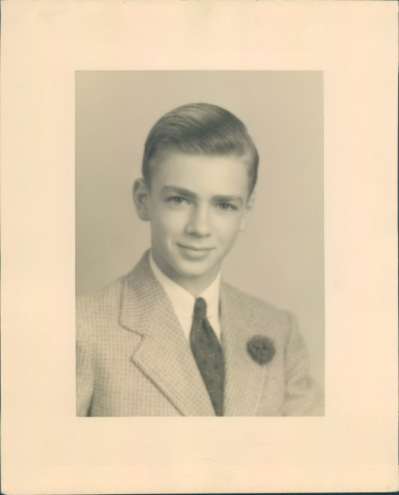
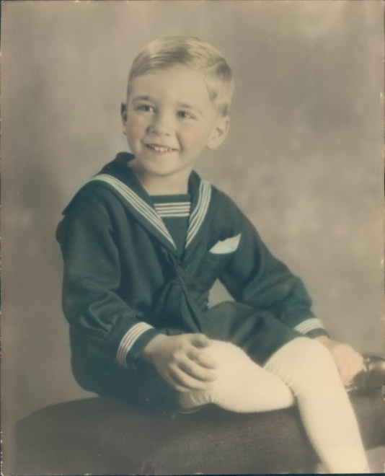
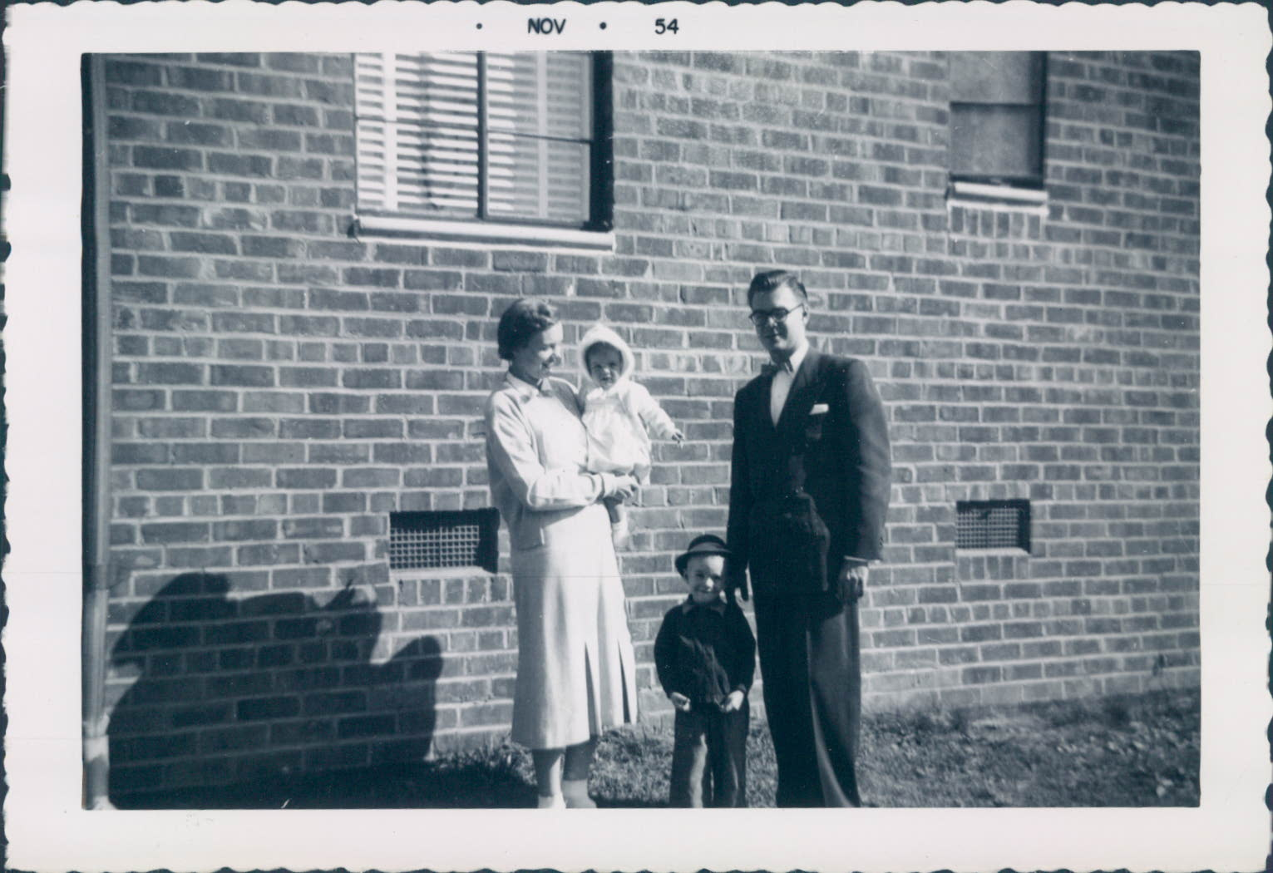
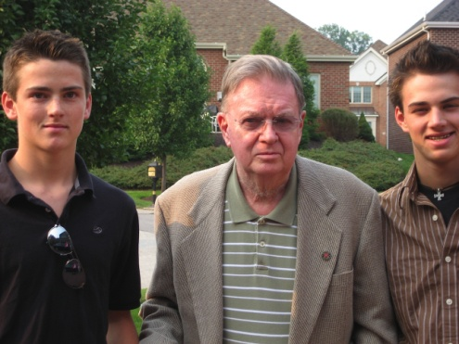
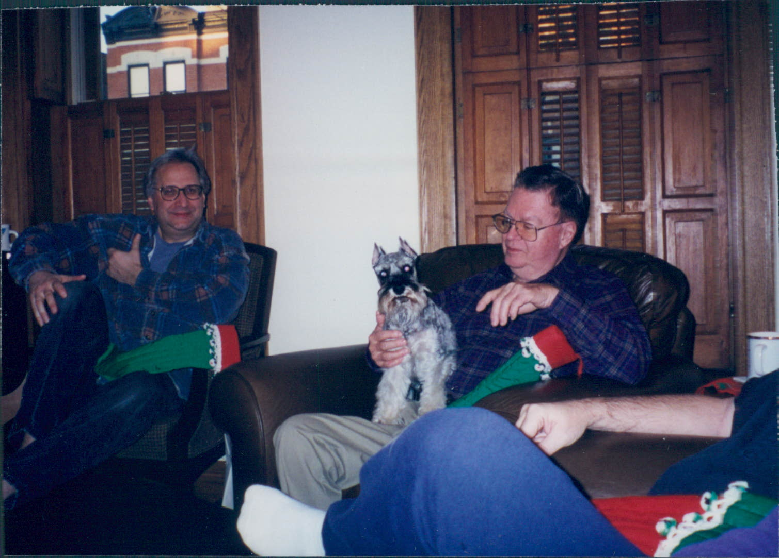
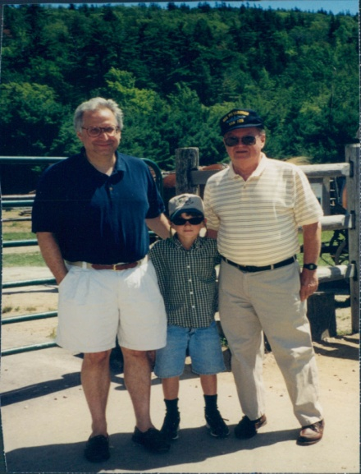
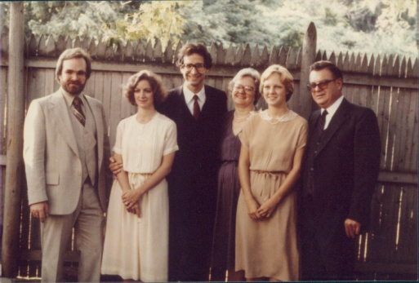
Bobs Life beyond Sig Ep

Slide 20
Thanks Bob
Bob joined Chi Beta Chi at UT prior to 1950.
Chi Beta Chi was a local fraternity. The Chi Bet’s had to decide what was best for their future.
Bob researched all of the national fraternities and he was adamant that Sigma Phi Epsilon was the right choice.
Bob was steadfast in his determination to become a SigEp. And his Chi Beta Brothers recommended other national fraternities but Bob refused to consider any other option but Sigma Phi Epsilon.

Slide 21
Thank you Bob- Your Unforgetable

Slide 22
Ohio Iota
Ohio Iota Officially Joined Sigma Phi Epsilon Fraternity on September 30, 1950.
Bob Signed the Original Charter for the 119th chapter to join the bonds of Sigma Phi Epsilon
Today, Sig Ep is over 15,000 active members
240 Chapters Nationwide
Over 300,000 members since 1901
SigEp was founded with the cardinal principles of Virtue, Diligence and Brotherly Love. Our mission is “Building Balanced Men,”

Slide 23
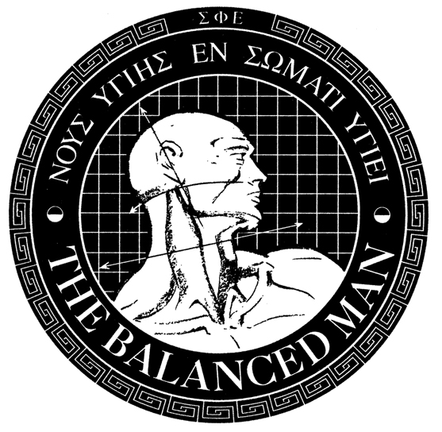
Bob..Your Unforgetable !

Slide 24
Sigma Phi Epsilon Presidents Club In memory of Robert Gates, Our First President

